Slide 1
Business Analytics Case Study
Lognormal Analytics
Manda Nitin Reddy

Slide 2
Problem Statement
As a business analyst for an online retailer, the task is to analyze historical sales data for 10 products across three categories - Electronics, Clothing, and Home Goods, to uncover key trends, segment drivers, and competitor impacts, and provide strategic, data-driven recommendations to support executive decision-making.

Slide 3
Objectives
Data Issues & Transformation
Basic Trend Overview
Address data quality issues and create useful analytical features.
Identify overall sales patterns and category performance.
Segment Influence Analysis
Trend Detection
Assess how product-related segments (e.g., ad spend, reviews) impact sales.
Detect sales trends over time and their influencing factors.
Competitor Impact Assessment
Strategic Recommendations
Analyzing effect of competitor pricing
Translate insights into actionable business strategies.

Slide 4
GPT promts:
About Weather Index and Market share rank and how can they influence sales, what does a weather index of 1 – 10 mean?
Dataset Overview:
We have a dataset covering multiple aspects of product performance and market dynamics, grouped into the following categories:
Product & Category Information
Product ID, Category, Product Name
Pricing & Competitor Analysis
Price, Competitor Price, Pricing Currency
Sales & Performance Metrics
Sales Volume, Advertising Spend (EUR), Market Share Rank
Customer & Social Data
Customer Reviews, Social Media Mentions
Operational & Environmental Data
Weather Index, Warehouse Stock Level

Slide 5
Data Quality & Transformations
GPT promts:
How drastic are the exchange rate fluctuations between TRY and EUR
Timestamp & Frequency: All records are timestamped at 10:23:19 and collected weekly from 16-May-2023 to 06-May-2025 (Tuesdays).
Missing Data (<2%):
Affected Columns: Sales Volume, Advertising Spend, Customer Reviews
No specific missing pattern observed.
Missing values were replaced with product-specific averages.
Price Column:
Issues: Negative values, values beyond 2 decimals, and some 0s.
Actions:
Replaced 0s and negatives as appropriate
Pricing Currency:
Values in EUR and TRY
All converted to EUR using average yearly exchange rates, considering minimal yearly fluctuation.
Sales Volume:
Null values replaced with average sales for that product.
Customer Reviews:
Null values replaced with average rating per product
Ratings above 5 (e.g., 6) capped at 5

Slide 6
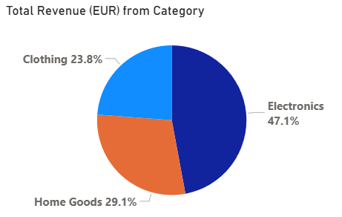
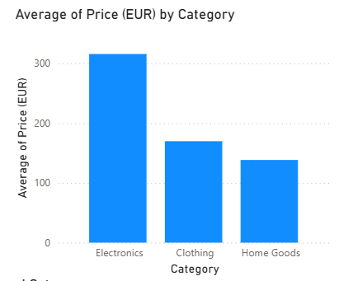
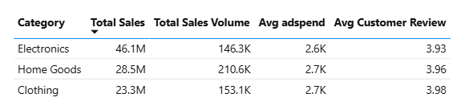
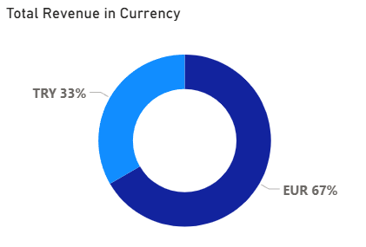
Basic Trend Analysis
Total Revenue: €98 Million
Total Sales Volume: 510,000 units
Average Advertising Spend: €2.6K per record
Average Customer Rating: 3.9 / 5.0
Most of the Revenue from Electronics.
Though the sales volume is less for electronics the revenue generated is higher due to the higher prices of products in Electronics category.
Despite an equal number of transactions in TRY and EUR, revenue generated in EUR is significantly higher.
Continued..

Slide 7
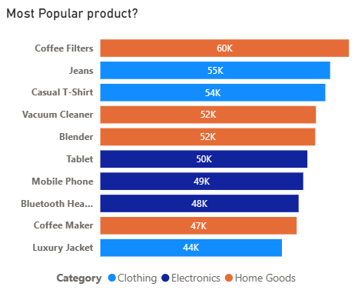
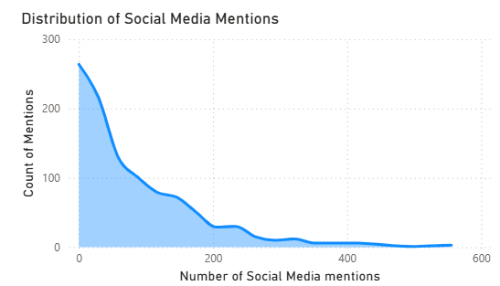
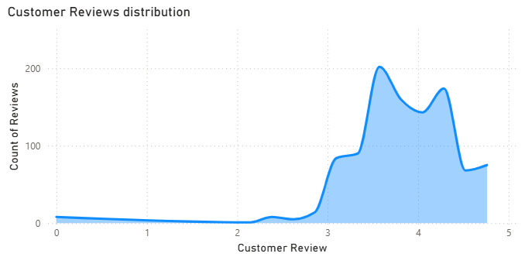
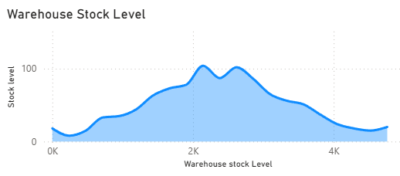
Coffee Filters is the most popular product
Social Media Mentions, most values clustered near zero, indicating limited online engagement for most products. A few have high popularity — the impact on sales should be further investigated.
Customer Reviews, with the majority of ratings above 3, suggesting generally positive customer sentiment.
Warehouse Stock Level, stock was available for most products across the timeline.

Slide 8
Segment Influence Analysis In this analysis, we aim to identify which factors and segments most significantly influence sales across categories. We evaluate the impact of advertising, customer sentiment, social engagement, stock levels, and competitive position on driving sales performance.
GPT promts:
About Segment Influence Analysis.
How market share rank is calculated
Best way to segment skewed distributions (will percentile vaues like 25, 30 be appropriate)

Slide 9
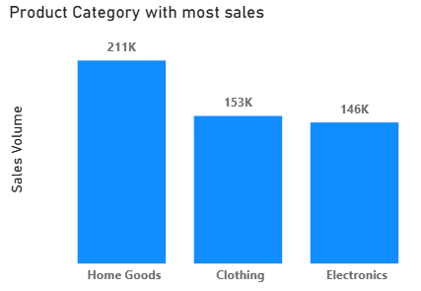
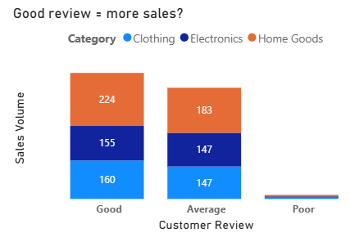
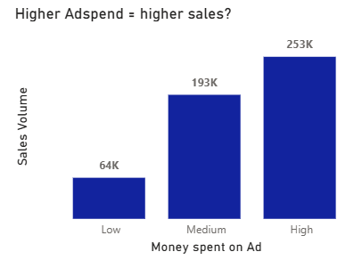
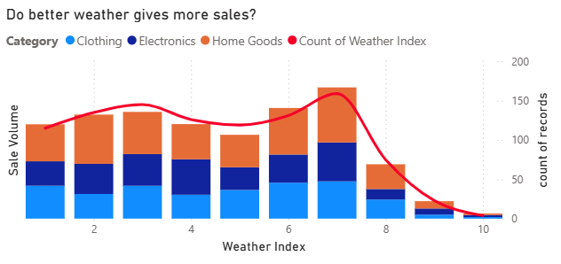
Home Goods generate the highest sales volume, followed by Clothing and Electronics revenue is higher from electronics as products are priced higher.
Customer Reviews are generally positive; poor ratings are rare, which limits conclusions about their impact on sales.
Weather Index shows no strong influence on sales. Lower sales at indexes 8–10 are likely due to fewer recorded days rather than actual weather impact.
Advertising Spend vs Sales: Spearman correlation is -0.02, suggesting no direct relationship. However, visual trends show higher ad spend segments tend to drive more sales.

Slide 10
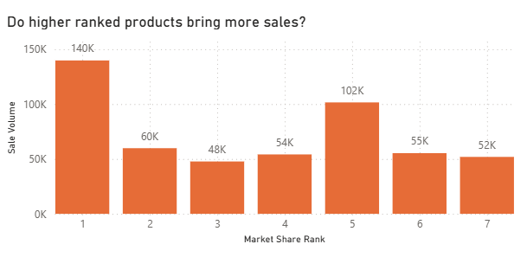
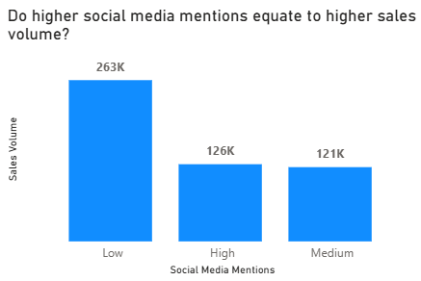
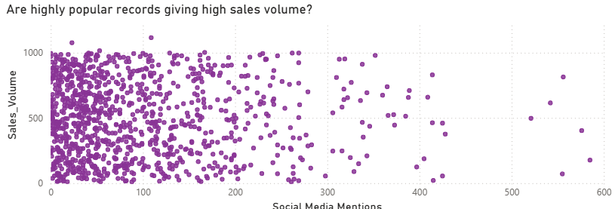
Market Share Rank: While rank 1 products sell the most, rank 5 products are the second highest in sales, indicating rank doesn’t consistently align with sales volume.
Social Media Mentions: Low mention products dominate in volume. High-mention products have mixed sales, not always the highest, suggesting weak correlation.

Slide 11
Trend Analysis. In this part, we look at how sales change over time. We try to find patterns, seasonality, and how factors like category, stock level, or customer behavior affect sales across time
GPT promts:
How to analyze dates that start from month of may instead of January
Low stock can impact sales but will having large stock also impact sales?
General peak seasons for categories like cloth, home goods and Electronics

Slide 12
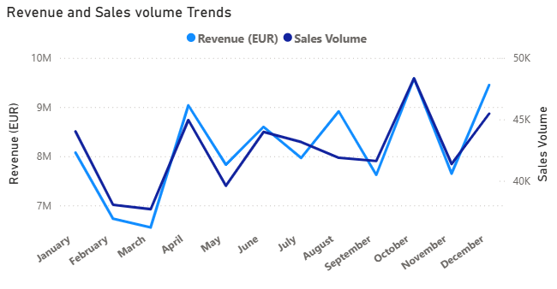
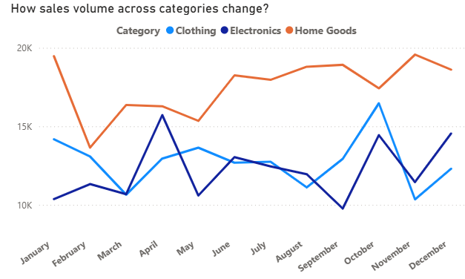
Revenue and Sales Volume Trends
Revenue and sales volume generally follow the same pattern, indicating a strong relationship.
In August, revenue increases while sales volume drops, this may suggest higher-value items like electronics were sold more.
Both February and March show dips in revenue and volume possibly due to some seasonal factors
Sales Volume by Category
Home Goods consistently drive high volumes, especially in Q3 and Q4,.
Electronics show volatile trends, with a notable drop in September, maybe due to less stock after august sales and also a sudden peak in April which also relates to sudden increase is revenue in month of April.
Clothing remains steady but peaks in April and October, which could align with season changes.

Slide 13
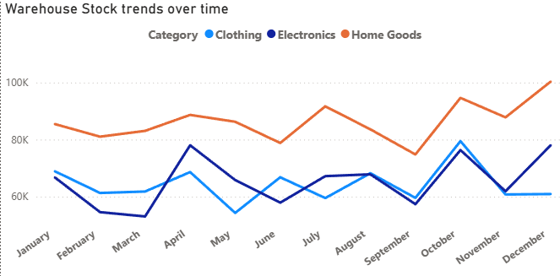
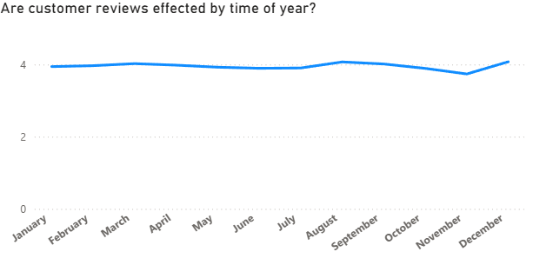
Warehouse Stock Trends
Home Goods maintain the highest stock levels, with peaks matching high sales months, indicates good inventory planning.
Electronics and Clothing stock levels are more variable, and lower stock in September may explain low sales for electronics then.
Customer Reviews Over Time
Average ratings are consistently near 4, showing strong customer satisfaction.
Very little variation across months, suggesting time of year doesn’t affect review quality significantly.

Slide 14
Competitor Impact Assessment Analyzing price differences with competitor by category, price segment gaps, and trends in competitor vs. our prices to understand pricing impact on sales.
GPT promts:
How big the price difference of competitor product should be to really see major impact in our sales
Which category products are more impacted by competitor price difference.

Slide 15
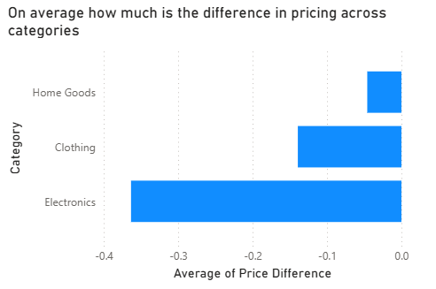
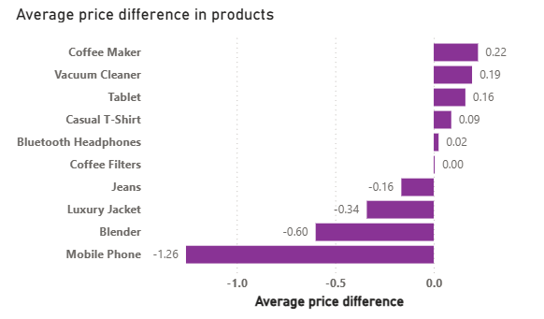
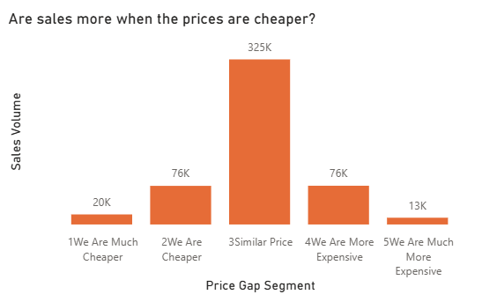
Sales vs. Price Gap: Sales peak when prices are similar to competitors, not necessarily when we're cheaper.
Category Pricing: Electronics are significantly cheaper than competitors on average, while Home Goods have minimal price differences.
Product-Level Gaps: Mobile Phones and Blenders show the largest negative price difference, indicating aggressive pricing.

Slide 16
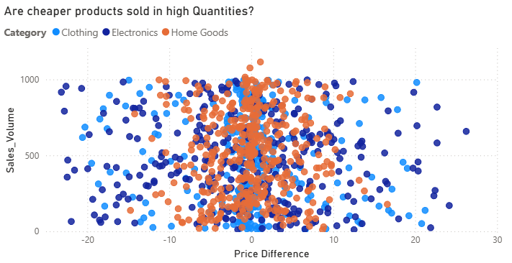
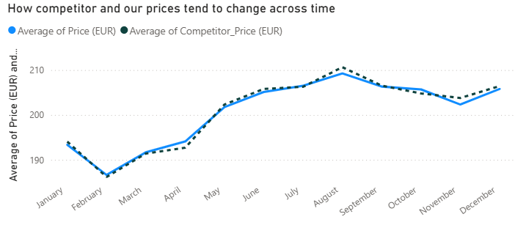
Category-Wise Sales Behavior:
Electronics: Sales are evenly spread across price differences, pricing has less impact.
Home Goods & Clothing: Perform best when prices are similar to competitor prices
Overall Price Sensitivity:
Most purchases happen when price differences are small.
Monthly Trend Alignment:
Our prices are closer to competitor pricing throughout the year.
In August, competitor prices rise more than ours, potentially boosting our relative price attractiveness and sales.

Slide 17
Key Insights
Electronics drive revenue despite lower sales volume, due to higher product prices.
Sales peak when our prices are similar to competitors, not necessarily when cheaper.
Home Goods have the highest sales volume, especially in Q3 and Q4.
Customer reviews are generally positive, indicating good product satisfaction.
Advertising spend shows no strong correlation to sales, but visually higher spend segments tend to perform better.
Recommendations
Improve social media engagement to raise awareness of high-rated, low-mention products.
Maintain price similar with competitors to maximize sales volume.
Boost advertising during key months (April, August, Q3–Q4) when sales naturally spike.
Promote high-volume products like Coffee Filters more actively across channels.

Slide 18
Thank You

